Slide 1
Data Structures
ICT-1211
Information and Communication Technology
Lecture-04
Date:

Slide 2
String Processing

Slide 3
Basic Terminology
Each programming language contains a character set that is used to communicate with the computer. This sets usually includes the following:
Alphabet: A B C D E F G H I J K L M N O P Q R S T U V W X Y Z
Digits: 0 1 2 3 4 5 6 7 8 9
Special characters: + - / * ( ) , . $ = ‘

Slide 4
String
A finite sequence S of zero or more characters is called a string.
The number of characters in a string is called its length.
The string with zero characters is called empty string or the null string.

Slide 5
String
Example:
‘THE END’
‘TO BE OR NOT TO BE’
‘ ‘
‘ ‘
Length: 7, 18, 0, 2.

Slide 6
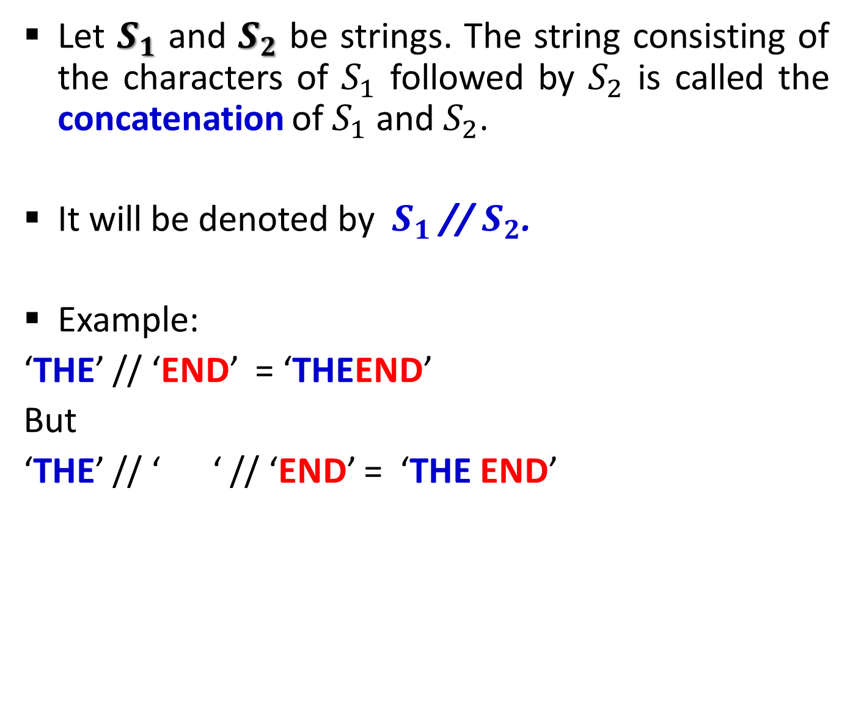
String
Let $S_{1}$ and $S_{2}$ be strings. The string consisting of the characters of $S_{1}$ followed by $S_{2}$ is called the concatenation of $S_{1}$ and $S_{2}$.
It will be denoted by $S_{1}$ // $S_{2}$.
Example:
‘THE’ // ‘END’ = ‘THEEND’
But
‘THE’ // ‘ ‘ // ‘END’ = ‘THE END’

Slide 7
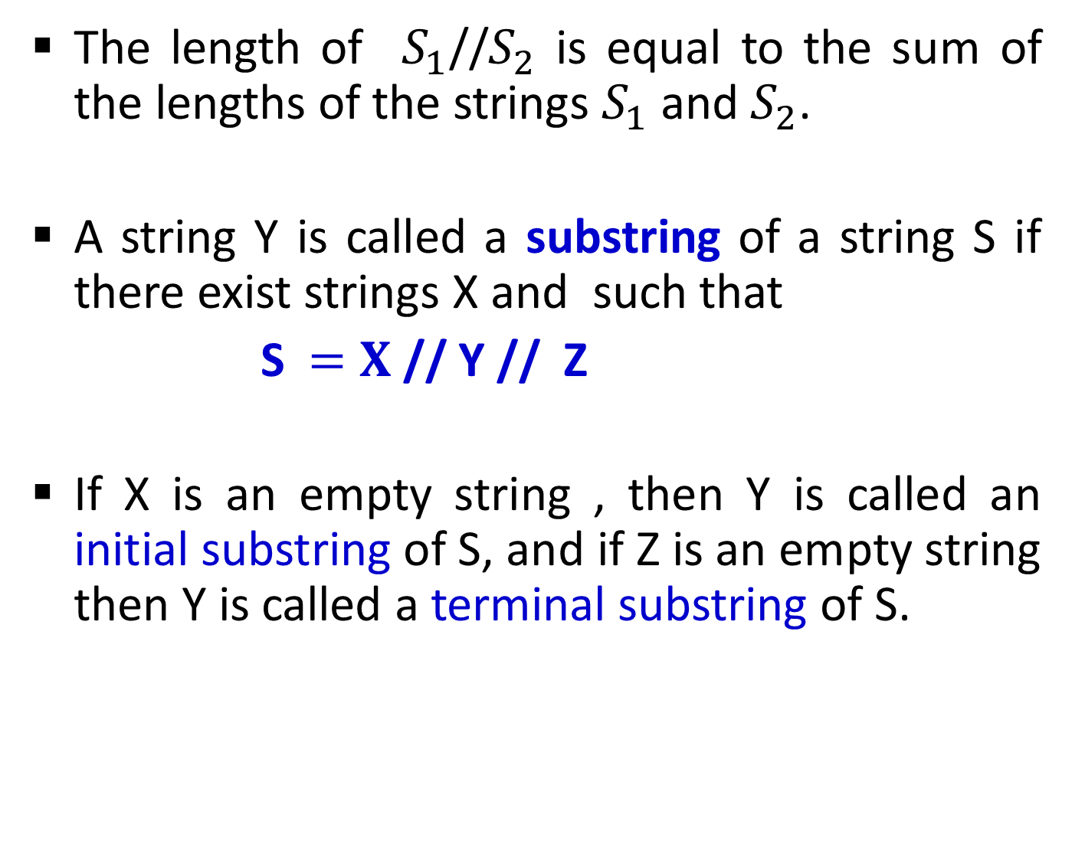
String
The length of $S_{1}$//$S_{2}$ is equal to the sum of the lengths of the strings $S_{1}$ and $S_{2}$.
A string Y is called a substring of a string S if there exist strings X and such that
S$=X$ // Y // Z
If X is an empty string , then Y is called an initial substring of S, and if Z is an empty string then Y is called a terminal substring of S.

Slide 8
String
Example:
‘BE OR NOT’ is a substring of ‘TO BE OR NOT TO BE’
‘THE’ is an initial substring of ‘THE END’
* If Y is a substring of S, then the length of Y cannot exceed the length of S.

Slide 9
Storing String
String are stored in three types of structures:
Fixed-length structures
Variable-length structures with fixed maximums
Linked structures

Slide 10

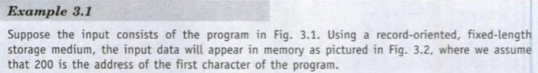
Storing String
Record-Oriented, Fixed-length Storage
.

Slide 11
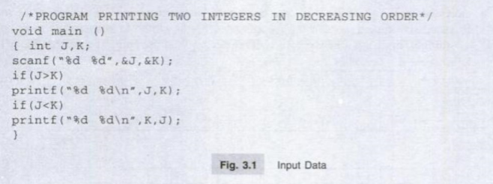
Storing String
Record-Oriented, Fixed-length Storage
.

Slide 12
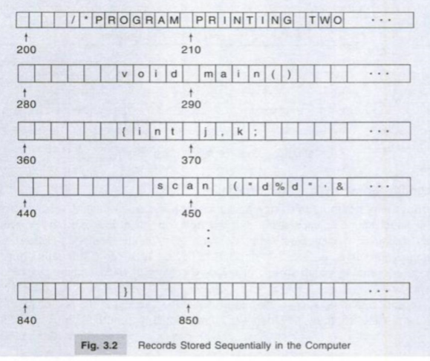
Storing String
Record-Oriented, Fixed-length Storage
.

Slide 13
Storing String
Record-Oriented, Fixed-length Storage
Advantages:
  The ease of accessing data from any given record.
  The ease of updating data in any given record ( as long as the length of the new data does not exceed the record length).
.

Slide 14
Storing String
Record-Oriented, Fixed-length Storage
Disadvantages:
  Time is wasted reading an entire record if most of the storage consists of inessential blank spaces.
  Certain records may require more space than available.
  When the correction consists of more or fewer characters than the original text, changing a misspelled word requires the entire record be changed.

Slide 15
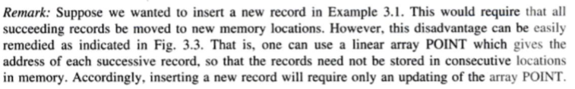
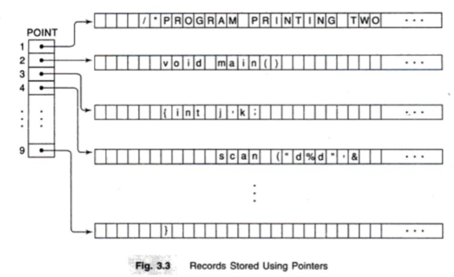
Storing String

Slide 16
Storing String
Variable-length Storage with Fixed Maximum
The storage of variable-length strings in memory cells with fixed lengths can be done in two general ways:
  One can use a marker, such as two dollar signs ($$), to signal the end of the string.
  One can list the length of the string – as an additional item in the pointer array.

Slide 17
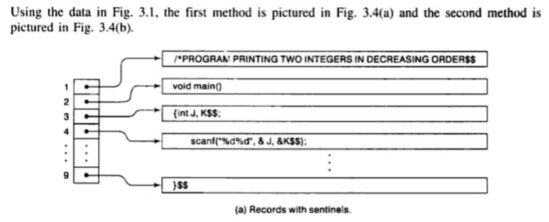
Storing String
Variable-length Storage with Fixed Maximum
Example:

Slide 18
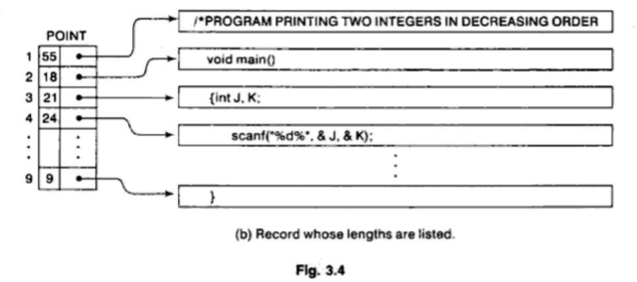
Storing String
Variable-length Storage with Fixed Maximum
Example:

Slide 19
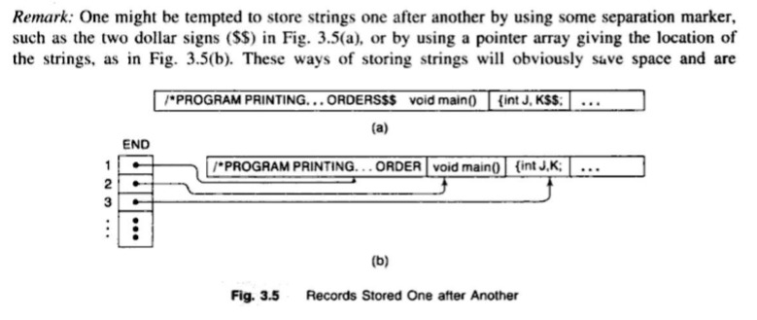
Storing String
Variable-length Storage with Fixed Maximum
Example:

Slide 20
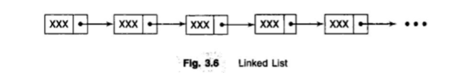
Storing String
Linked Storage
By a (one way) linked list, we mean a linearly ordered sequence of memory cells, called nodes, where each node contains an item, called link , which points to the next node in the list (i.e. , which contains the address of the next node). Figure 3-6 is a schematic diagram of such linked list.

Slide 21
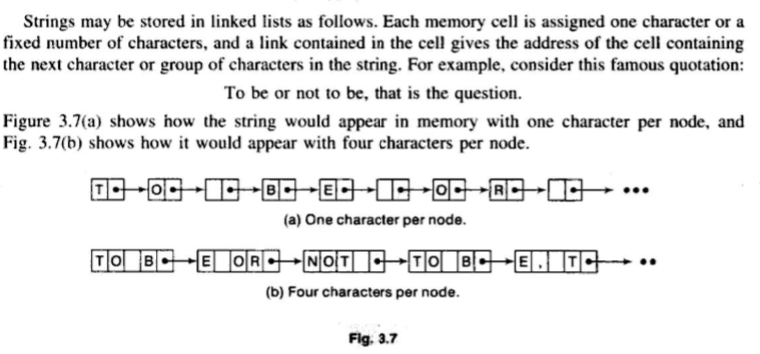
Storing String
Linked Storage

Slide 22
Character Data Type
Constants:
Many programming languages denote string constants by placing the string in either single or double quotation marks. For example:
‘THE END’ and ‘TO BE OR NOT TO BE’
are string constants of lengths 7 and 18 characters respectively.

Slide 23
Character Data Type
Variables:
Types of variables:
  Static variable
  Semistatic variable
  Dynamic variable

Slide 24
Character Data Type
Variables:
Static variable:
By a static character variable, we mean a variable whose length is defined before the program is executed and cannot change throughout the program.

Slide 25
Character Data Type
Variables:
Semistatic variable:
By a semistatic character variable, we mean a variable whose length may vary during the execution of the program as long as the length does not exceed a maximum value determined by the program before the program is executed.

Slide 26
Character Data Type
Variables:
Dynamic variable:
By a dynamic character variable, we mean a variable whose length can change during the execution of the program.

Slide 27
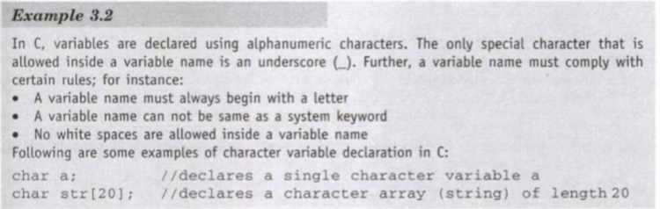
Character Data Type

Slide 28
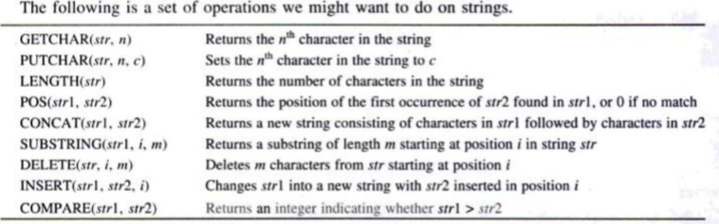
String Operation

Slide 29
String Operation
Substring:
Accessing a substring from a given string requires three pieces of information:
The name of the string or the string itself.
The position of the first character of the substring in the given string
The length of the substring of the position of the last character of the substring.
We call this operation SUBSTRING. Specially we can write
SUBSTRING (string, initial, length)

Slide 30
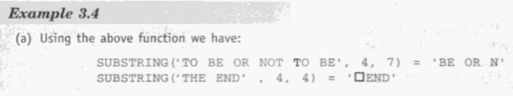
String Operation
Substring:
SUBSTRING (string, initial, length)

Slide 31
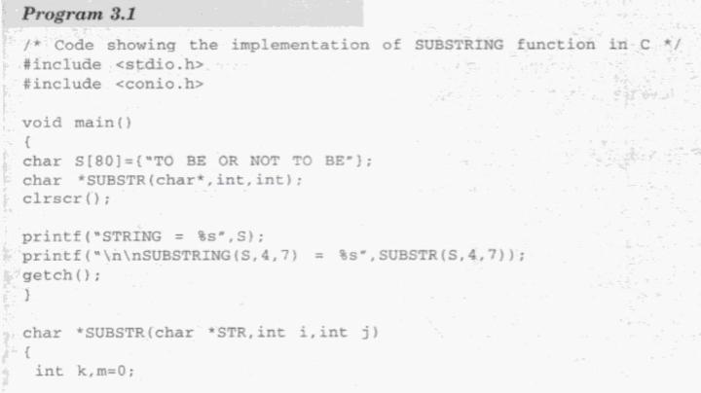
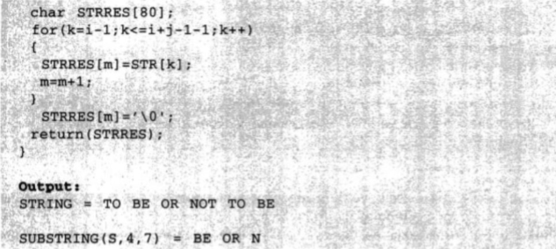
String Operation

Slide 32
Thank you……

